Slide 1
Design Principles vs. Performance
How my growing knowledge about internals and performance characteristics of the .NET Runtime changed the design of my apps – an anecdotal talk
.NET Developer Group Graz 02.03.2021

Slide 2
Table of Contents
How did I structure my apps up to the year 2015?
Performance of everyday things
What did I learn about performance?
Memory Management and GC in the .NET Runtime
async await, Threading and the Thread Pool in the .NET Runtime
How did this change my software design?
SOLID Principles – the good, the bad, the ugly
Should we introduce new principles?

Slide 3

About Me
Kenny Pflug
Senior Software Developer at Synnotech
PhD candidate at the university of Regensburg, Germany
Twitter: @feO2x
GitHub: feO2x
YouTube: youtube.com/c/kennypflug

Slide 4
Around 2015…

Slide 5
How did I structure my code in 2015?
I created many small classes, usually containing only a single functionality
Between caller and callee, I always tried to place an interface / abstract base class to achieve loose coupling
The resulting object graphs would be resolved via Dependency Injection (DI) – usually with the help of a DI container.
If-Else or Switch blocks will be replaced with several objects implementing the same abstraction – each object represents a single if branch
I tried to use established Design Patterns
Test-Driven Development – I like to write the failing test first.

Slide 6
2015 – Design Patterns
Factory, Abstract Factory
Builder
Singleton
Prototype
Adapter
Composite
Decorator
Facade
Proxy
Chain of Responsibility
Command
Iterator
Mediator
Memento
Observer
Strategy
Visitor
Immutable Objects
Arrange – Act – Assert (– Cleanup)
Dummy, Stub, Spy, Mock
Model – View – View Model
Model – View – Controller
Object Pooling
und viele mehr…

Slide 7
2015 – Software Architectures: N-Layer / N-Tier
Presentation
Application
Infrastructure
Business
Data Access

Slide 8
2015 – Software Architectures: Ports and Adapters / Onion Architecture
Presentation
Other Port
Business
Infrastructure
Data Access

Slide 9
2015 – Software Architectures: Ports and Adapters / Onion Architecture
Presentation
Other Port
What about performance?
Business
Infrastructure
Data Access

Slide 10
Performance of Everyday Things

Slide 11
Time flies…
1e-12
1e-9
1e-6
1e-3
Picoseconds
Nanoseconds (ns)
Microseconds (µs)
Milliseconds (ms)
Seconds (s)

Slide 12
A few words about the .NET Runtime…
Roslyn
CSC
MSIL exe, DLLs
.cs
.NET Runtime
JIT
Just-In-Time Compiler
GC Garbage Collector
Threads and the Thread Pool
Machine Code
Additional Services

Slide 13
Performance of Different Operations in Nanoseconds

Slide 14
What Should We Learn From This Chart?
Multithreading has overhead, you can run many thousand operations before parallelizing or moving a calculation to another thread.
New threads are expensive, if possible, we should use the ones of the Thread Pool
Exceptions are the most expensive control flow mechanism. If possible, try to stick to other flow control constructs like if-else, switch, and loops.
I/O is way more expensive than in-memory operations
Measure performance by yourself
Does it scale?

Slide 15
Thread Stacks and the Managed Heap in .NET

Slide 16
Thread Stack and Managed Heap (1)
Thread Stack
Managed Heap
Return Address (Caller of Main)

Slide 17
Thread Stack and Managed Heap (2)
Thread Stack
Managed Heap
myFriends (List<Person>): ???
Return Address Main
Return Address (Caller of Main)

Slide 18
Thread Stack and Managed Heap (3)
Thread Stack
Managed Heap
Activation Frame / Stack Frame
Parameters first
Return Address afterwards
Variables at the end
myFriends (List<Person>): ???
Return Address Main
Return Address (Caller of Main)

Slide 19
Thread Stack and Managed Heap (4)
Thread Stack
Managed Heap
List<Person>
myFriends (List<Person>): ???
_items (Person[]): null
Return Address Main
_size (int): 0
_version (int): 0
Return Address (Caller of Main)
_syncRoot (object): null

Slide 20
Thread Stack and Managed Heap (5)
Thread Stack
Managed Heap
Return Address MakeGoodFriends
capacity (int): 2
this (List<Person>): ref
List<Person>
myFriends (List<Person>): ???
_items (Person[]): null
Return Address Main
_size (int): 0
_version (int): 0
Return Address (Caller of Main)
_syncRoot (object): null

Slide 21
Thread Stack and Managed Heap (6)
Thread Stack
Managed Heap
Person[]
[0] (Person): null
Return Address MakeGoodFriends
[1] (Person): null
capacity (int): 2
this (List<Person>): ref
List<Person>
myFriends (List<Person>): ???
_items (Person[]): ref
Return Address Main
_size (int): 0
_version (int): 0
Return Address (Caller of Main)
_syncRoot (object): null

Slide 22
Thread Stack and Managed Heap (7)
Thread Stack
Managed Heap
Person[]
[0] (Person): null
[1] (Person): null
List<Person>
myFriends (List<Person>): ref
_items (Person[]): ref
Return Address Main
_size (int): 0
_version (int): 0
Return Address (Caller of Main)
_syncRoot (object): null

Slide 23
Thread Stack and Managed Heap (8)
Thread Stack
Managed Heap
string „Walter“
newPerson (Person): ???
Person[]
Return Address MakeGoodFriends
[0] (Person): null
age (int): 54
[1] (Person): null
name (string): ref
list (List<Person>): ref
List<Person>
myFriends (List<Person>): ref
_items (Person[]): ref
Return Address Main
_size (int): 0
_version (int): 0
Return Address (Caller of Main)
_syncRoot (object): null

Slide 24
Thread Stack and Managed Heap (9)
Thread Stack
Managed Heap
Person
Return Address CreateAndAddPerson
_name (string): null
age (int): 54
_age (int): 0
name (string): ref
string „Walter“
this (Person): ref
newPerson (Person): ???
Person[]
Return Address MakeGoodFriends
[0] (Person): null
age (int): 54
[1] (Person): null
name (string): ref
list (List<Person>): ref
List<Person>
myFriends (List<Person>): ref
_items (Person[]): ref
Return Address Main
_size (int): 0
_version (int): 0
Return Address (Caller of Main)
_syncRoot (object): null

Slide 25
Thread Stack and Managed Heap (10)
Thread Stack
Managed Heap
Person
Return Address CreateAndAddPerson
_name (string): ref
age (int): 54
_age (int): 0
name (string): ref
string „Walter“
this (Person): ref
newPerson (Person): ???
Person[]
Return Address MakeGoodFriends
[0] (Person): null
age (int): 54
[1] (Person): null
name (string): ref
list (List<Person>): ref
List<Person>
myFriends (List<Person>): ref
_items (Person[]): ref
Return Address Main
_size (int): 0
_version (int): 0
Return Address (Caller of Main)
_syncRoot (object): null

Slide 26
Thread Stack and Managed Heap (11)
Thread Stack
Managed Heap
Person
Return Address CreateAndAddPerson
_name (string): ref
age (int): 54
_age (int): 54
name (string): ref
string „Walter“
this (Person): ref
newPerson (Person): ???
Person[]
Return Address MakeGoodFriends
[0] (Person): null
age (int): 54
[1] (Person): null
name (string): ref
list (List<Person>): ref
List<Person>
myFriends (List<Person>): ref
_items (Person[]): ref
Return Address Main
_size (int): 0
_version (int): 0
Return Address (Caller of Main)
_syncRoot (object): null

Slide 27
Thread Stack and Managed Heap (12)
Thread Stack
Managed Heap
Person
_name (string): ref
_age (int): 54
string „Walter“
newPerson (Person): ref
Person[]
Return Address MakeGoodFriends
[0] (Person): null
age (int): 54
[1] (Person): null
name (string): ref
list (List<Person>): ref
List<Person>
myFriends (List<Person>): ref
_items (Person[]): ref
Return Address Main
_size (int): 0
_version (int): 0
Return Address (Caller of Main)
_syncRoot (object): null

Slide 28
Thread Stack and Managed Heap (13)
Thread Stack
Managed Heap
Person
_name (string): ref
_age (int): 54
string „Walter“
newPerson (Person): ref
Person[]
Return Address MakeGoodFriends
[0] (Person): ref
age (int): 54
[1] (Person): null
name (string): ref
list (List<Person>): ref
List<Person>
myFriends (List<Person>): ref
_items (Person[]): ref
Return Address Main
_size (int): 1
_version (int): 1
Return Address (Caller of Main)
_syncRoot (object): null

Slide 29
Thread Stack and Managed Heap (14)
Thread Stack
Managed Heap
Person
_name (string): ref
_age (int): 54
string „Walter“
Person[]
[0] (Person): ref
[1] (Person): null
List<Person>
myFriends (List<Person>): ref
_items (Person[]): ref
Return Address Main
_size (int): 1
_version (int): 1
Return Address (Caller of Main)
_syncRoot (object): null

Slide 30
Thread Stack and Managed Heap (15)
Thread Stack
Managed Heap
Person
_name (string): ref
_age (int): 27
string „Jesse“
Person
_name (string): ref
_age (int): 54
string „Walter“
newPerson (Person): ref
Person[]
Return Address MakeGoodFriends
[0] (Person): ref
age (int): 27
[1] (Person): ref
name (string): ref
list (List<Person>): ref
List<Person>
myFriends (List<Person>): ref
_items (Person[]): ref
Return Address Main
_size (int): 2
_version (int): 2
Return Address (Caller of Main)
_syncRoot (object): null

Slide 31
Thread Stack and Managed Heap (16)
Thread Stack
Managed Heap
Person
_name (string): ref
_age (int): 27
string „Jesse“
Person
_name (string): ref
_age (int): 54
string „Walter“
Person[]
[0] (Person): ref
[1] (Person): ref
List<Person>
_items (Person[]): ref
_size (int): 2
_version (int): 2
Return Address (Caller of Main)
_syncRoot (object): null

Slide 32
Properties of Thread Stacks
Every thread has its own thread stack. It is mainly used to handle the data of parameters and variables while methods are executing on the thread.
When a method is called, the so-called Activation Frame / Stack Frame is pushed. It consists of
All parameters
The return address
All variables of the method
After pushing the Activation Frame, all statements of the method will be executed.
After the last statement of a method is executed, the Activation Frame is “deallocated”. Actually, a pointer is moved to the Activation Frame of the caller method. Subsequent method calls will overwrite the corresponding memory of the thread stack.

Slide 33
Garbage Collector Runs

Slide 34
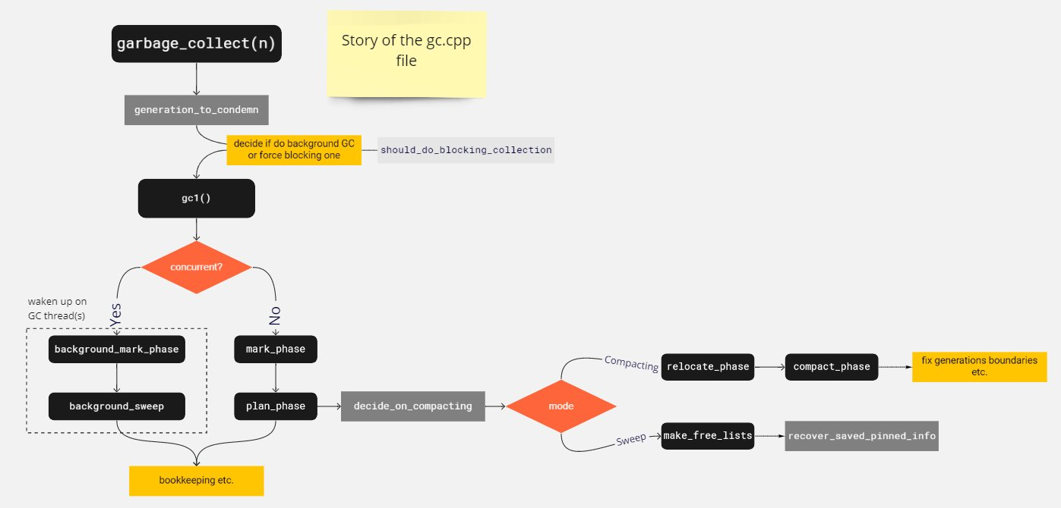
How GC Runs Are Performed
Konrad Kokosa via Twitter

Slide 35
How Does the GC Work Internally?
The GC performs so-called Runs to identify and deallocate objects that are no longer referenced by the process. The freed memory can be compacted.
Several different modes come into play:
Concurrent Background vs. Foreground
Workstation vs. Server Mode
There are four phases, depending on the mode, the GC will run through them differently
Mark
Plan
Sweep
Compact
The managed heap is split into the Small Object Heap (SOH) and the Large Object Heap (LOH) / User Old Heap (UOH).
Objects lesser than 85.000 bytes are placed in the SOH. The SOH is further divided into three generations – when you allocate objects, they usually are placed in the SOH.
During the Mark phase, the GC uses so-called GC Roots as entry points to the Managed Heap. These are:
Variables and Parameters on Thread Stacks
Static Fields
Objects with Finalizers / Destructors
Pinned Objects

Slide 36
How to Program With and not Against the GC?
If you don’t allocate, then the GC won’t perform runs
Try to move compute-intensive calculations to thread stacks
Reduce the number of threads your process allocates
Avoid hidden allocations:
Closure / Lexical Scoping in anonymous methods, for example when using LINQ
Avoid blocking threads on the Thread Pool
Avoid string concatenations (use StringBuilder where appropriate)
Reduce Reflection-based calculations as these allocate on every run -> check if Code Generation is a better option
Check your framework / libraries for performance issues
Data Binding mechanism (Data Binding in WPF -> x:Bind is way better)
DI Container (Unity Container less than version 5)
Serialization Frameworks (JSON.NET vs System.Text.Json)
Object-Relational Mappers (Entity Framework old version, not Core)

Slide 37
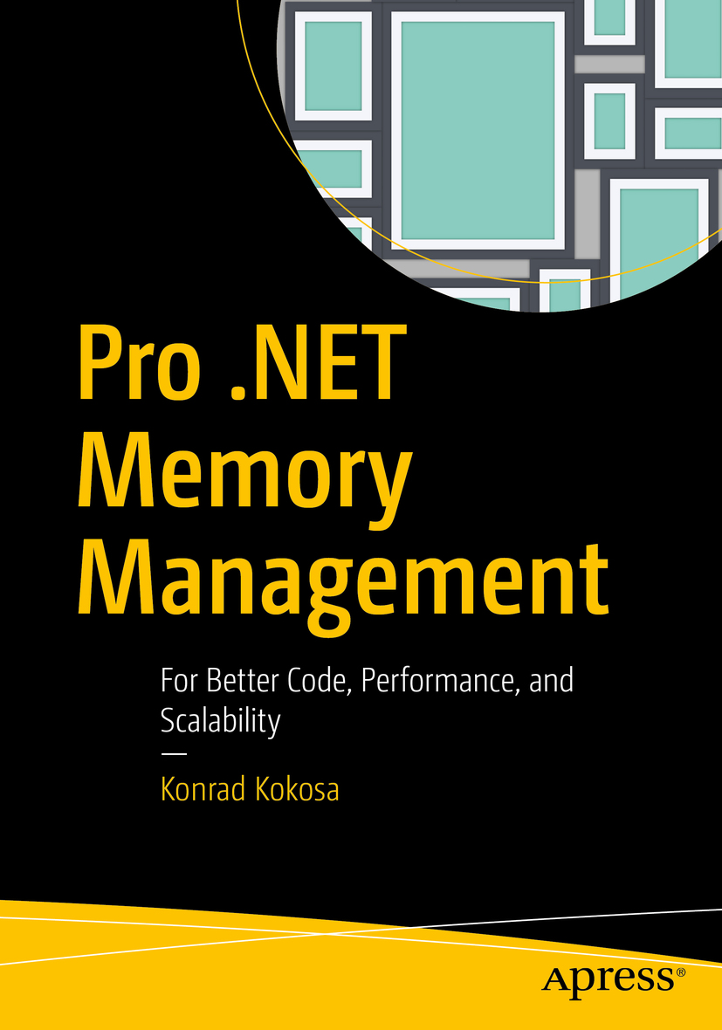
Pro .NET Memory Management

Slide 38
Asynchronous Programming in .NET

Slide 39
What is Asynchronous Programming?
Asynchronous Programming means that a method returns to the caller while its result (return value or side effects) are not readily available. The result will be given to the caller later (usually via an event-like mechanism). Until then, the caller can perform other calculations.
Async Multithreading (CPU-Bound)
Async I/O (I/O-Bound)

Slide 40
A Few Things About Threads
Memory usage:
1 MB (x86) or 4 MB (x64) Thread Stack (User Mode) by default
12 KB (x86) or 14 KB (x64) Kernel Mode Object
Context Switching
Lx Cache Misses

Slide 41
Why is Async I/O Important?
When I/O is performed via a synchronous API, the calling thread blocks while the third-party system (database, web service, etc.) calculates and sends the result
When the Thread Pool observes blocked threads while handling a lot of work, it will create new threads

Slide 42






Threading in Services in .NET
Thread Pool
Process Boundary
HTTP Request

Slide 43
Overhead of Async Methods
The exact overhead is hard to determine as it always involves memory fences
Your at least in the span of microseconds
This means you should make a clear design decision whether a method is async or not

Slide 44
What You Should Know About Async
The compiler will transform a method marked with async into a state machine
The state machine will return to the caller, while an async operation is being performed
The MoveNext method of the state machine will be called again when an async operation is done
If the calling thread has a SynchronizationContext, the MoveNext call will be queued to this thread, otherwise the continuation will be executed by a Thread Pool thread
The state machine has overhead – consider carefully if a method needs to be async or not
Async I/O is especially important for service apps as threads can handle other requests while third-party systems are calculating the results of async I/O operations

Slide 45
Example for Async I/O: Writing to a File
User Mode
FileStream.WriteAsync(byte[])
Continuation
IAsyncStateMachine.MoveNext
I/O Completion Port Thread
Async Procedure Call I/O Completion Port
Win32 Overlapped I/O
Win32 Overlapped I/O
Kernel Mode
Deferred Procedure Call
Device Driver
Device Driver
CPU Interrupt
DMA + Disk Controller

Slide 46
Design Principles vs. Performance
Caution: highly subjective

Slide 47

About SOLID: SRP
Single Responsibility Principle:
A class should only have one reason to change
I think a better name would be “Single Problem Area Principle”?

Slide 48
About SOLID: DIP and OCP
Dependency Inversion Principle
High-level modules should not depend upon low-level modules. Both should depend upon abstractions.
Abstractions should not depend upon details. Details should depend upon abstractions.
Open / Closed Principle
Software entities (classes, modules, functions, etc.) should be open for extension, but closed for modification.
Both these principles cover similar topics – isn’t it possible to combine them?

Slide 49
New Programming Principle: LTI
Learn The Internals Principle (LTI)
Study the internals of the runtimes and frameworks / libraries that you use and understand how they solve recurring problems. Examine which call patterns will result in problems / undesirable outcome and ensure that these patterns are avoided in your code base.

Slide 50
New Programming Principle: RPB
Respect the Process Boundary Principle (RBP)
Make a clear distinction between in-memory and I/O operations as the latter usually have way longer execution times. Consider performing I/O asynchronous so that the calling threads can perform other work while an I/O operation is ongoing.

Slide 51
The IPO Principle
Input
Process
Output
In-Memory Operations,
can be tightly coupled
Async I/O
Loosely Coupled

Slide 52
The Beauty of Imperative Code and Static Methods
Imperative statements are perfect for orchestration code
If a similar / the same step needs to be performed in two orchestrators, then use a simple Extract-Method refactoring and call the resulting method
static method calls need no additional object dependencies
Dependencies to perform I/O can be passed via method injection
In general: I/O calls should be loosely-coupled, but Core Logic can be tightly coupled. Introduce abstractions to your Core Logic as needed.

Slide 53
CHUC: Core – Humble Objects – Unit Tests – Composition Root
Process Boundary
Abstraction
Humble Objects
Core
Unit Tests
Composition Root

Slide 54
New Principle: RTH
Resist The Hype Principle (RTH)
You can solve problems in many ways. Regard any design pattern, principle, language feature, framework / library, runtime feature, etc. as a tool. Do not use any of these without a specific reason. There is no one-size-fits-all solution to problems.

Slide 55
Quellen
Matt Waren: The 68 things the CLR does before executing a single line of your code (*)
Konrad Kokosa: Pro .NET Memory Management
Jeffrey Richter: Advanced Threading in .NET
Daniel Palme: IoC Container Benchmark - Performance comparison
Joseph Albahari: Threading in C#
John Skeet: Asynchronous C# 5.0
Robert C. Martin: Agile Principles, Patterns, and Practices in C#
Andrey Akinshin: Pro .NET Benchmarking – The Art of Performance Measurement
Martin Fowler: Patterns of Enterprise Application Architecture
Mark Seemann: Dependency Injection in .NET

Slide 56
Thank you!
Questions?

Slide 57
Memory Maps for an Async Method

Slide 58
Memory Map: at the Beginning of the Async Method
Thread Stack
Managed Heap
RoutedEventArgs
string „20“
machine (AsyncStateMashine)
TextBox
State (int): ???
Text (string): ref
Builder (AsyncTaskMethodBuilder<long>)
…
TaskAwaiter (TaskAwaiter<long>)
TextBlock
TextBlock
ParsedNumber (int): ???
Text (string): null
ToTextBox (TextBox): ???
…
StackPanel
ResultTextBlock (TextBlock): ???
ProgressRing (ProgressRing): ???
ProgressRing
TextBlock
Button (Button): ???
Visibility (Visibility): Collapsed
Return Address
…
Stackpanel
e (RoutedEventArgs): ref
Button
sender (object): ref
MainWindow
IsEnabled (bool): true
WPF Render Loop…
…
App

Slide 59
Memory Map: Before AsyncTaskMethodBuilder.Start
Thread Stack
Managed Heap
RoutedEventArgs
string „20“
machine (AsyncStateMashine)
TextBox
State (int): -1
Text (string): ref
Builder (AsyncTaskMethodBuilder<long>)
…
TaskAwaiter (TaskAwaiter<long>)
TextBlock
TextBlock
ParsedNumber (int): 0
Text (string): null
ToTextBox (TextBox): ref
…
StackPanel
ResultTextBlock (TextBlock): ref
ProgressRing (ProgressRing): ref
ProgressRing
TextBlock
Button (Button): ref
Visibility (Visibility): Collapsed
Return Address
…
Stackpanel
e (RoutedEventArgs): ref
Button
sender (object): ref
MainWindow
IsEnabled (bool): true
WPF Render Loop…
…
App

Slide 60
Memory Map: at the Beginning of the First MoveNext Call
Thread Stack
Managed Heap
lowestCommonMultiple (int): ???
localTaskAwaiter (TaskAwaiter<long>): ???
Return Address
this (AsyncStateMachine): ref
AsyncMethodBuilderCore.Start
RoutedEventArgs
AsyncTaskMethodBuilder.Start
string „20“
machine (AsyncStateMashine)
TextBox
State (int): -1
Text (string): ref
Builder (AsyncTaskMethodBuilder<long>)
…
TaskAwaiter (TaskAwaiter<long>)
TextBlock
TextBlock
ParsedNumber (int): 20
Text (string): null
ToTextBox (TextBox): ref
…
StackPanel
ResultTextBlock (TextBlock): ref
ProgressRing (ProgressRing): ref
ProgressRing
TextBlock
Button (Button): ref
Visibility (Visibility): Collapsed
Return Address
…
Stackpanel
e (RoutedEventArgs): ref
Button
sender (object): ref
MainWindow
IsEnabled (bool): true
WPF Render Loop…
…
App

Slide 61
Memory Map: After Task.Run
Thread Stack
Managed Heap
Thread Stack 2
lowestCommonMultiple (int): ???
Task
localTaskAwaiter (TaskAwaiter<long>): ???
Lexical Capture
Return Address
upperLimit (int): 20
this (AsyncStateMachine): ref
Delegate
AsyncMethodBuilderCore.Start
RoutedEventArgs
AsyncTaskMethodBuilder.Start
string „20“
machine (AsyncStateMashine)
TextBox
State (int): -1
Text (string): ref
Builder (AsyncTaskMethodBuilder<long>)
…
TaskAwaiter (TaskAwaiter<long>)
TextBlock
TextBlock
ParsedNumber (int): 20
Text (string): null
ToTextBox (TextBox): ref
…
StackPanel
ResultTextBlock (TextBlock): ref
ProgressRing (ProgressRing): ref
ProgressRing
TextBlock
i (long): ???
Button (Button): ref
Visibility (Visibility): Visible
denominators (List<int>): ???
Return Address
…
Stackpanel
Return Address
e (RoutedEventArgs): ref
Button
upperLimit (int): 20
sender (object): ref
MainWindow
Dispatch…
IsEnabled (bool): false
WPF Render Loop…
…
App
ThreadPoolWaitCallback

Slide 62
Memory Map: at the End of Builder.AwaitOnCompleted
Thread Stack
Managed Heap
Thread Stack 2
Builder.AwaitOnCompleted…
AsyncStateMachineBox<AsyncStateMachine>
Task
machine (AsyncStateMachine):
lowestCommonMultiple (int): ???
State (int): 0
localTaskAwaiter (TaskAwaiter<long>)
Lexical Capture
Builder (AsyncTaskMethodBuilder<long>)
Return Address
upperLimit (int): 20
TaskAwaiter (TaskAwaiter<long>)
this (AsyncStateMachine): ref
Delegate
ParsedNumber (int): 20
AsyncMethodBuilderCore.Start
RoutedEventArgs
ToTextBox (TextBox): ref
string „20“
ResultTextBlock (TextBlock): ref
AsyncTaskMethodBuilder.Start
ProgressRing (ProgressRing): ref
machine (AsyncStateMashine)
TextBox
Button (Button): ref
State (int): 0
Text (string): ref
Builder (AsyncTaskMethodBuilder<long>)
…
TaskAwaiter (TaskAwaiter<long>)
TextBlock
TextBlock
ParsedNumber (int): 20
Text (string): null
ToTextBox (TextBox): ref
…
StackPanel
ResultTextBlock (TextBlock): ref
ProgressRing (ProgressRing): ref
ProgressRing
TextBlock
i (long): ???
Button (Button): ref
Visibility (Visibility): Visible
denominators (List<int>): ???
Return Address
…
Stackpanel
Return Address
e (RoutedEventArgs): ref
Button
upperLimit (int): 20
sender (object): ref
MainWindow
Dispatch…
IsEnabled (bool): false
WPF Render Loop…
…
App
ThreadPoolWaitCallback

Slide 63
Memory Map: Return to the Calling Method
Thread Stack
Managed Heap
Thread Stack 2
AsyncStateMachineBox<AsyncStateMachine>
Task
machine (AsyncStateMachine):
State (int): 0
Lexical Capture
Builder (AsyncTaskMethodBuilder<long>)
upperLimit (int): 20
TaskAwaiter (TaskAwaiter<long>)
Delegate
ParsedNumber (int): 20
RoutedEventArgs
ToTextBox (TextBox): ref
string „20“
ResultTextBlock (TextBlock): ref
ProgressRing (ProgressRing): ref
machine (AsyncStateMashine)
TextBox
Button (Button): ref
State (int): 0
Text (string): ref
Builder (AsyncTaskMethodBuilder<long>)
…
TaskAwaiter (TaskAwaiter<long>)
TextBlock
TextBlock
ParsedNumber (int): 20
Text (string): null
ToTextBox (TextBox): ref
…
StackPanel
ResultTextBlock (TextBlock): ref
ProgressRing (ProgressRing): ref
ProgressRing
TextBlock
i (long): ???
Button (Button): ref
Visibility (Visibility): Visible
denominators (List<int>): ???
Return Address
…
Stackpanel
Return Address
e (RoutedEventArgs): ref
Button
upperLimit (int): 20
sender (object): ref
MainWindow
Dispatch…
IsEnabled (bool): false
WPF Render Loop…
…
App
ThreadPoolWaitCallback

Slide 64
Memory Map: Return to the WPF Render Loop
Thread Stack
Managed Heap
Thread Stack 2
AsyncStateMachineBox<AsyncStateMachine>
Task
machine (AsyncStateMachine):
State (int): 0
Lexical Capture
Builder (AsyncTaskMethodBuilder<long>)
upperLimit (int): 20
TaskAwaiter (TaskAwaiter<long>)
Delegate
ParsedNumber (int): 20
RoutedEventArgs
ToTextBox (TextBox): ref
string „20“
ResultTextBlock (TextBlock): ref
ProgressRing (ProgressRing): ref
TextBox
Button (Button): ref
Text (string): ref
…
TextBlock
TextBlock
Text (string): null
…
StackPanel
ProgressRing
TextBlock
i (long): ???
Visibility (Visibility): Visible
denominators (List<int>): ???
…
Stackpanel
Return Address
Button
upperLimit (int): 20
MainWindow
Dispatch…
IsEnabled (bool): false
WPF Render Loop…
…
App
ThreadPoolWaitCallback

Slide 65
Memory Map: Progress on the Background Thread
Thread Stack
Managed Heap
Thread Stack 2
AsyncStateMachineBox<AsyncStateMachine>
Task
machine (AsyncStateMachine):
State (int): 0
Lexical Capture
Builder (AsyncTaskMethodBuilder<long>)
upperLimit (int): 20
TaskAwaiter (TaskAwaiter<long>)
Delegate
ParsedNumber (int): 20
RoutedEventArgs
ToTextBox (TextBox): ref
string „20“
ResultTextBlock (TextBlock): ref
ProgressRing (ProgressRing): ref
TextBox
Button (Button): ref
Text (string): ref
…
TextBlock
TextBlock
List<int>
Text (string): null
…
StackPanel
ProgressRing
TextBlock
i (long): …
Visibility (Visibility): Visible
denominators (List<int>): ref
…
Stackpanel
Return Address
Button
upperLimit (int): 20
MainWindow
Many delegates…
Dispatch…
IsEnabled (bool): false
WPF Render Loop…
…
App
ThreadPoolWaitCallback

Slide 66
Memory Map: After the Task is Completed
Thread Stack
Managed Heap
Thread Stack 2
AsyncStateMachineBox<AsyncStateMachine>
Task
machine (AsyncStateMachine):
State (int): 0
Lexical Capture
Builder (AsyncTaskMethodBuilder<long>)
upperLimit (int): 20
TaskAwaiter (TaskAwaiter<long>)
Delegate
ParsedNumber (int): 20
RoutedEventArgs
ToTextBox (TextBox): ref
string „20“
ResultTextBlock (TextBlock): ref
ProgressRing (ProgressRing): ref
TextBox
Button (Button): ref
Text (string): ref
…
TextBlock
TextBlock
List<int>
Text (string): null
…
StackPanel
ProgressRing
TextBlock
Visibility (Visibility): Visible
…
Stackpanel
Button
MainWindow
Many delegates…
IsEnabled (bool): false
Dispatch…
WPF Render Loop…
…
App
ThreadPoolWaitCallback

Slide 67
Memory Map: Continuation on the UI Thread
Thread Stack
Managed Heap
Thread Stack 2
AsyncStateMachineBox<AsyncStateMachine>
Task
machine (AsyncStateMachine):
State (int): 0
Lexical Capture
Builder (AsyncTaskMethodBuilder<long>)
upperLimit (int): 20
TaskAwaiter (TaskAwaiter<long>)
Delegate
ParsedNumber (int): 20
RoutedEventArgs
ToTextBox (TextBox): ref
string „20“
ResultTextBlock (TextBlock): ref
ProgressRing (ProgressRing): ref
TextBox
Button (Button): ref
Text (string): ref
…
TextBlock
TextBlock
List<int>
Text (string): null
…
StackPanel
ProgressRing
TextBlock
lowestCommonMultiple (int): ???
Visibility (Visibility): Visible
localTaskAwaiter (TaskAwaiter<long>): ???
…
Stackpanel
Return Address
Button
this (AsyncStateMachine): ref
MainWindow
Many delegates…
IsEnabled (bool): false
WPF Render Loop…
…
App
ThreadPoolWaitCallback

Slide 68
Memory Map: Getting the Result via LocalTaskAwaiter
Thread Stack
Managed Heap
Thread Stack 2
AsyncStateMachineBox<AsyncStateMachine>
Task
machine (AsyncStateMachine):
State (int): -1
Lexical Capture
Builder (AsyncTaskMethodBuilder<long>)
upperLimit (int): 20
TaskAwaiter (TaskAwaiter<long>): default
Delegate
ParsedNumber (int): 20
RoutedEventArgs
ToTextBox (TextBox): ref
string „20“
ResultTextBlock (TextBlock): ref
ProgressRing (ProgressRing): ref
TextBox
Button (Button): ref
Text (string): ref
…
TextBlock
TextBlock
List<int>
Text (string): null
…
StackPanel
ProgressRing
TextBlock
lowestCommonMultiple (int): ???
Visibility (Visibility): Visible
localTaskAwaiter (TaskAwaiter<long>)
…
Stackpanel
Return Address
Button
this (AsyncStateMachine): ref
MainWindow
Many delegates…
IsEnabled (bool): false
WPF Render Loop…
…
App
ThreadPoolWaitCallback

Slide 69
Memory Map: Updating the Controls
Thread Stack
Managed Heap
Thread Stack 2
Result String „…“
AsyncStateMachineBox<AsyncStateMachine>
Task
machine (AsyncStateMachine):
State (int): -2
Lexical Capture
Builder (AsyncTaskMethodBuilder<long>)
upperLimit (int): 20
TaskAwaiter (TaskAwaiter<long>): default
Delegate
ParsedNumber (int): 20
RoutedEventArgs
ToTextBox (TextBox): ref
string „20“
ResultTextBlock (TextBlock): ref
ProgressRing (ProgressRing): ref
TextBox
Button (Button): ref
Text (string): ref
…
TextBlock
TextBlock
List<int>
Text (string): ref
…
StackPanel
ProgressRing
TextBlock
lowestCommonMultiple (int): 232792560
Visibility (Visibility): Collapsed
localTaskAwaiter (TaskAwaiter<long>)
…
Stackpanel
Return Address
Button
this (AsyncStateMachine): ref
MainWindow
Many delegates…
IsEnabled (bool): true
WPF Render Loop…
…
App
ThreadPoolWaitCallback

Slide 70
Memory Map: Final Return to the WPF Render Loop
Thread Stack
Managed Heap
Thread Stack 2
Result String „…“
AsyncStateMachineBox<AsyncStateMachine>
Task
machine (AsyncStateMachine):
State (int): -1
Lexical Capture
Builder (AsyncTaskMethodBuilder<long>)
upperLimit (int): 20
TaskAwaiter (TaskAwaiter<long>): default
Delegate
ParsedNumber (int): 20
RoutedEventArgs
ToTextBox (TextBox): ref
string „20“
ResultTextBlock (TextBlock): ref
ProgressRing (ProgressRing): ref
TextBox
Button (Button): ref
Text (string): ref
…
TextBlock
TextBlock
List<int>
Text (string): ref
…
StackPanel
ProgressRing
TextBlock
Visibility (Visibility): Collapsed
…
Stackpanel
Button
MainWindow
Many delegates…
IsEnabled (bool): true
WPF Render Loop…
…
App
ThreadPoolWaitCallback

